Slide 1
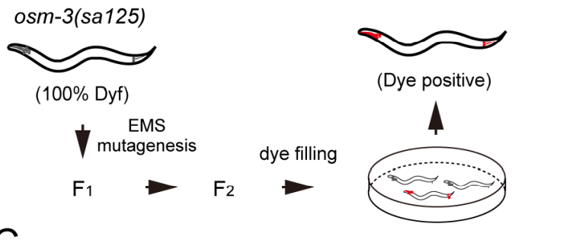
Osm-3 p802
G444E
Mapping
Whole Genome Sequencing
Phenotype II
dye-filling
Phenotype I
Compare with wildtype
And Mapping samples
~300 Single nucleotide variation due to EMS
Can focus on about ¼ length of a Chromosome

Slide 2
Screening
Screening
5-6 Samples
50-100 Samples
Mapping
Sequencing
1 month
Analyze
Sequencing
Next-gen seq is becoming cheaper
Can get a lot of allele and gene once a screen
Mapping free
Accurate and save a lot of money

Slide 3
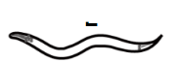
Step 1: Creat a SNP pool with SNPs have impact on amino acid
Tag
Impact SNP pool
Of Sup 1
Suppressor mutant 1
taglist
NEKL-4 SNP
SNP of all
……

Slide 4
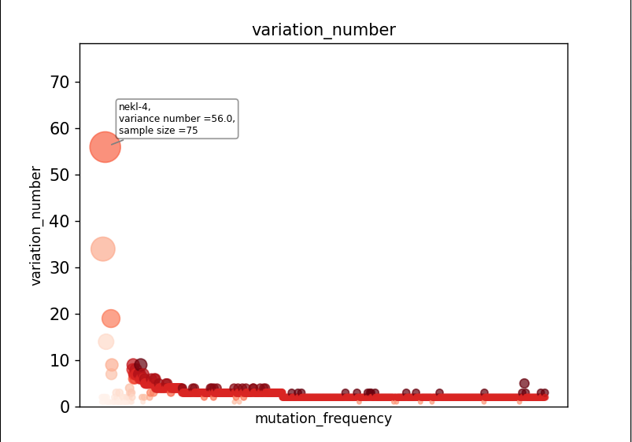
Sample size = 95

Slide 5
Step 2: Remove low possibility SNPs
Gene
Gene
Gene
1.If Nekl-4 is a suppressor
You can hardly find another suppressor
Gene In nekl-4 SNP pool
Gene
SNP Pool
Of All Input
SNP Pool
2.Because that almost all the SNPs in
SNP pool have an impact on protein
structure and amino acid. Genes linked
to the SNPs in the suppressor pool
can be considered as ‘not likely’ as well
Gene
Of Nekl-4 mutant
Gene
(intersection factor = 3%)
Problem: Impact SNP cannot be decided easily so there
might be a lot of false-negative cases

Slide 6
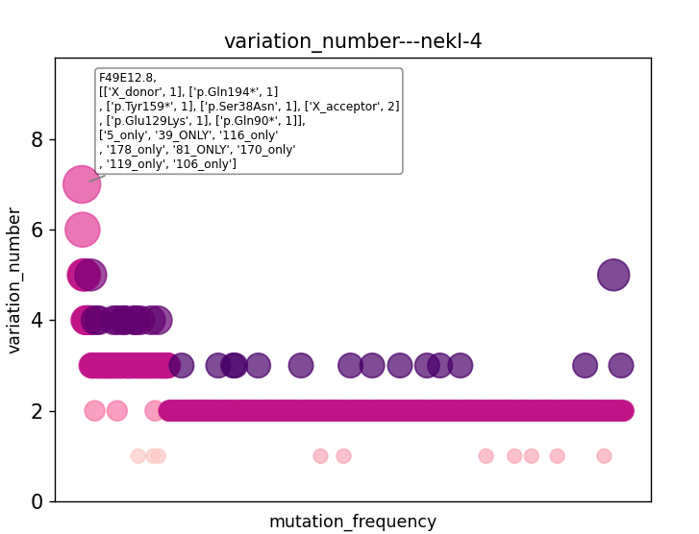

Slide 7
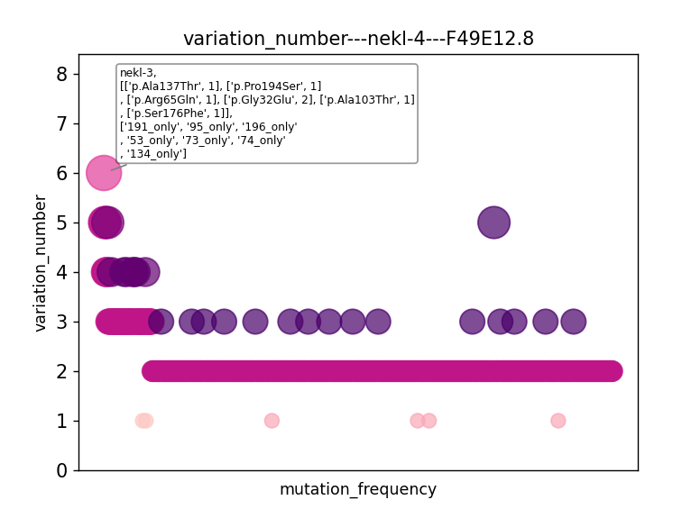

Slide 8
Using statistical model to distinguish genes
(Why suppressors can exclude each other)
Gene A= 75
Gene B = 7
If genes are randomly distributed:
c
n
95-n
1
2
3
4
5
6
.
.
.
95
+
+
+
+
+
+
+
P(A+,B+)=
n
P(++)
(1-P(++))
95
When suppressor screening:
H0 : B is not a suppressor
P = P(A+,B+)*P(no-sup)
P(no-sup)=n(no sup SNP)/(n(all SNP)-n(A SNP))
What about the P adjustment when multiple comparison?

Slide 9
To explain the reason that nekl-4 share a suppressor mutant with nekl-3
1. P(no-sup) = (9703-95)/(9703-75)
c
n
95-n
2. P(nekl-4+,nekl-3+) =
n
P(++)
(1-P(++))
95
3.P(++) = (7/95)*(75/95) = 0.0582
When one of them is no-suppressor mutation:
c
n
95-n
2. P(nekl-4+,nekl-3+) =
n
* 0.0582
* 0.9418
* P(no-sup)
95

Slide 10
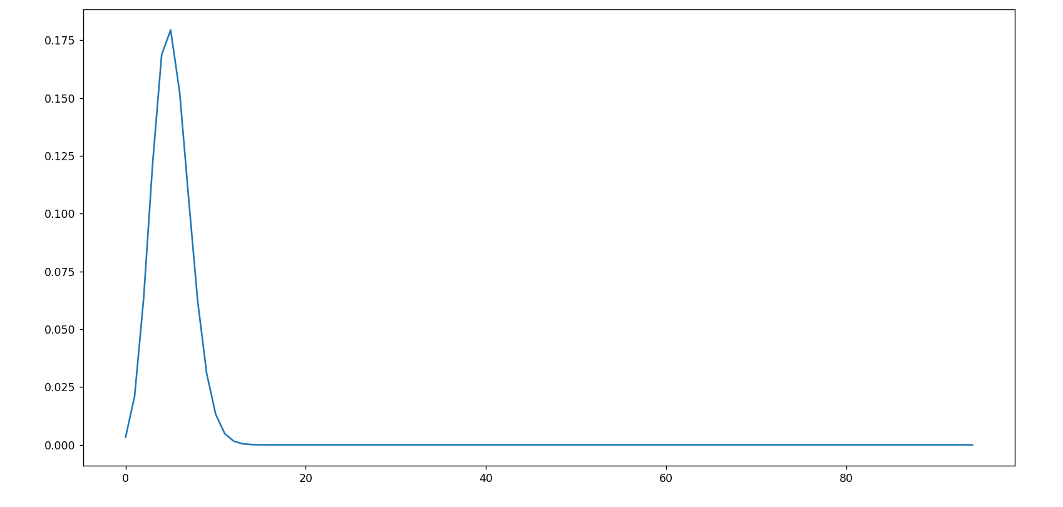
Both them are no-suppressor mutations: nekl-4(75) vs nekl-3(7)
c
n
95-n
P(nekl-4+,nekl-3+) =
n
* 0.0582
* 0.9418
*P(no sup)
95
P < 0.05: x<2.04 or x > 8.4

Slide 11
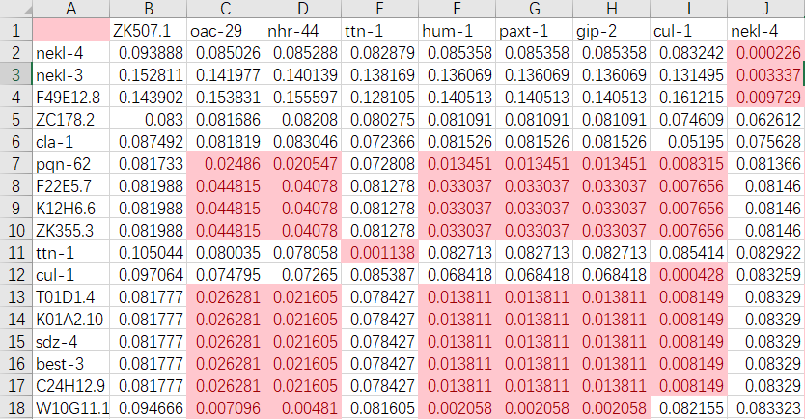
Gene to gene p value
P<0.05: n<a suppressor n>b enhancer?

Slide 12
SNP pool of
osm-3(sa125) suppressors
Unc-89
Nekl-4
ttn-1
Gene x

Slide 13
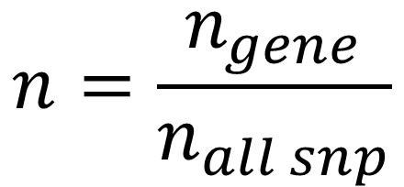
Toy data：Che-3, osm-3, unc-89, let-418
gene
Sample size
SNP number
Gene a
Gene b
Gene c
Gene d
95
98
43
175
95000
98000
43000
175000
26
5
5
3
6
2
1
1
33
32
16
45
1 (+1)
0 (+1)
0 (+1)
1 (+1)
Che-3
osm-3
unc-89
let-418
1. normalization
$$n=\frac{n_{gene}}{n_{all snp}}$$

Slide 14
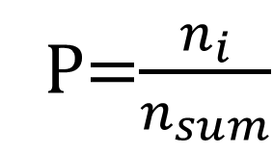
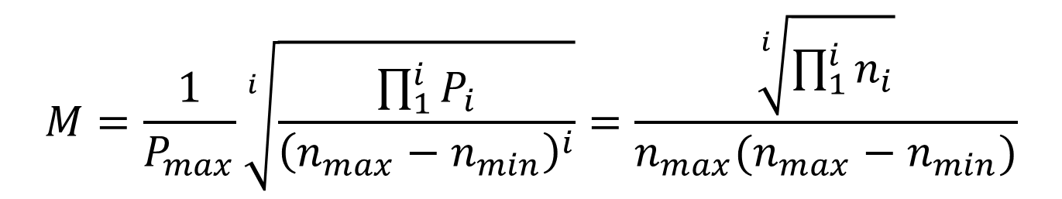
Get the M score of a gene in different screenings
$$M=\frac{1}{P_{max}}\sqrt[i]{\frac{\prod_{1}^{i}{P_{i}}}{{\left(n_{max}−n_{min}\right)}^{i}}}=\frac{\sqrt[i]{\prod_{1}^{i}{n_{i}}}}{n_{max}(n_{max}−n_{min})}$$
P=$\frac{n_{i}}{n_{sum}}$
gene
Sample size
Gene a
Gene b
SNP number
Gene c
Gene d
95
98
43
175
95000
98000
43000
175000
0.391
-
-
-
2.129
-
-
-
7.552
-
-
-
-
-
23.5
-
Che-3
osm-3
unc-89
let-418
Conclusion:
Gene a and Gene b might be the candidate of che-3 screening, Gene c and Gene d is a trash

Slide 15
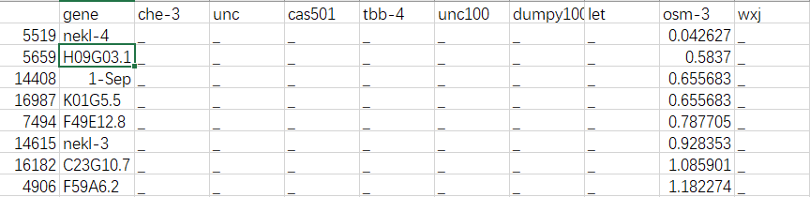
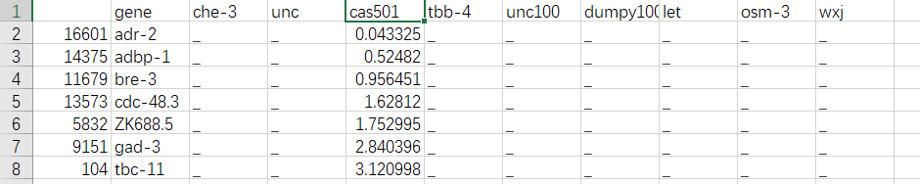
Osm-3 G444E
Dyf-5 T164E

Slide 16
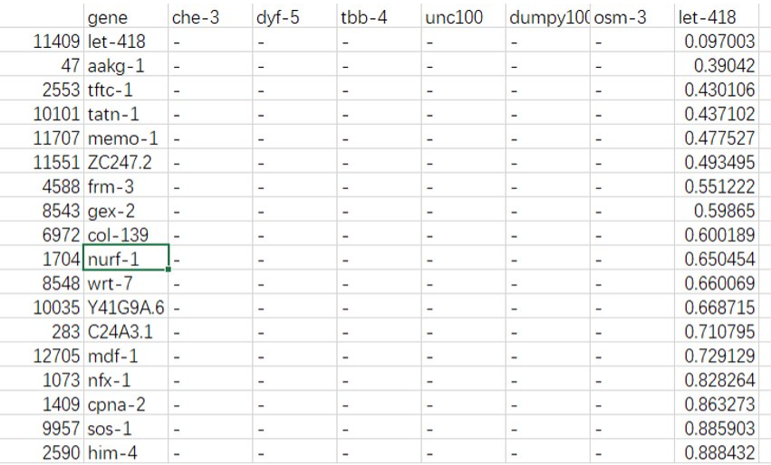
Let-418

Slide 17
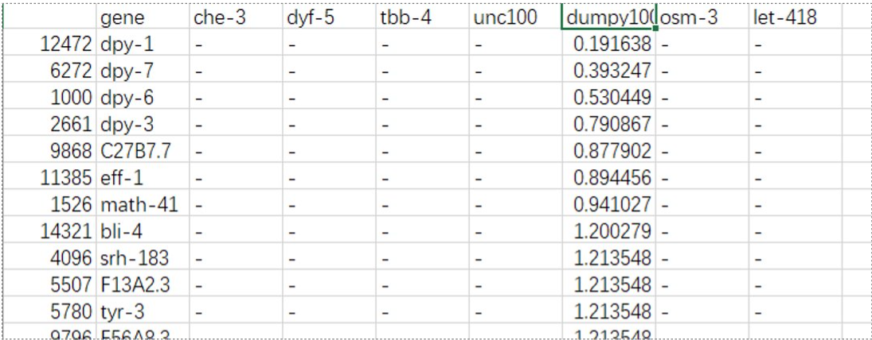
dumpy

Slide 18
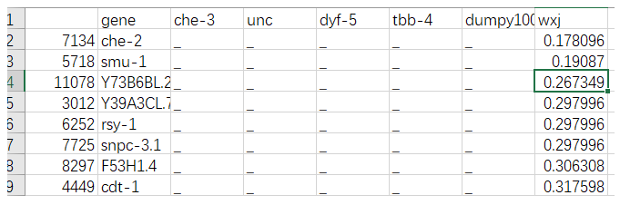

Slide 19
Unsolved problems：
Unexpected noise？
Alignmentみたいな点数システムを作りたい

Slide 20
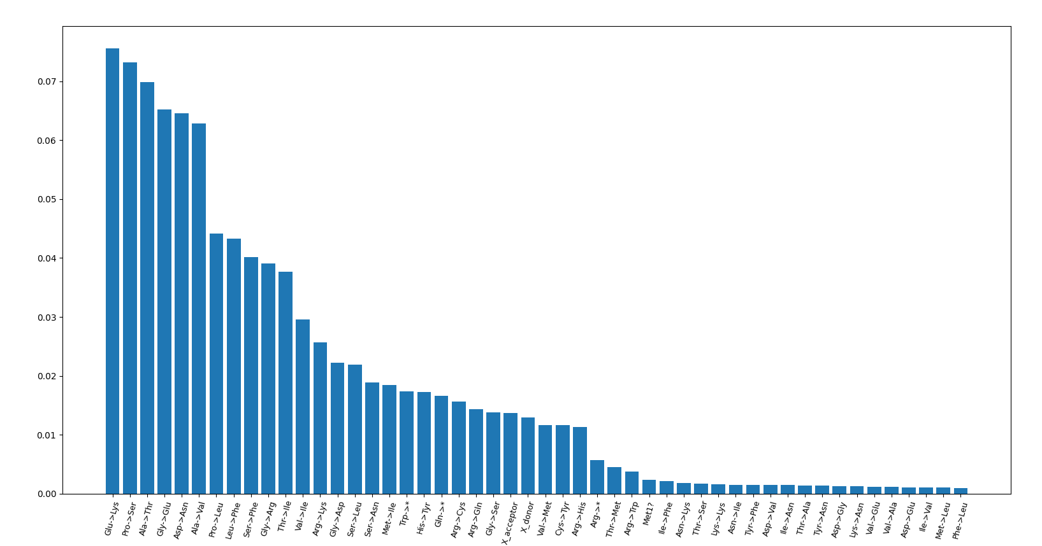
TBB-4(sa127)

Slide 21
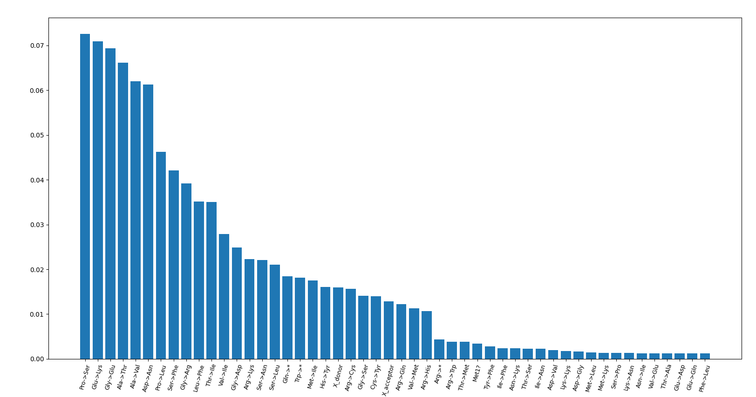
dumpy

Slide 22
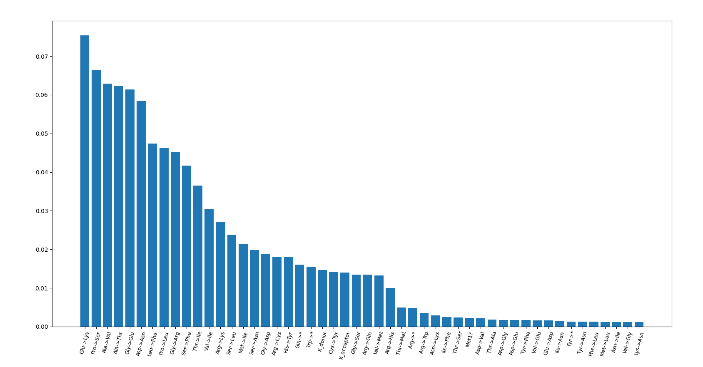
Dyf-5(cas501)

Slide 23
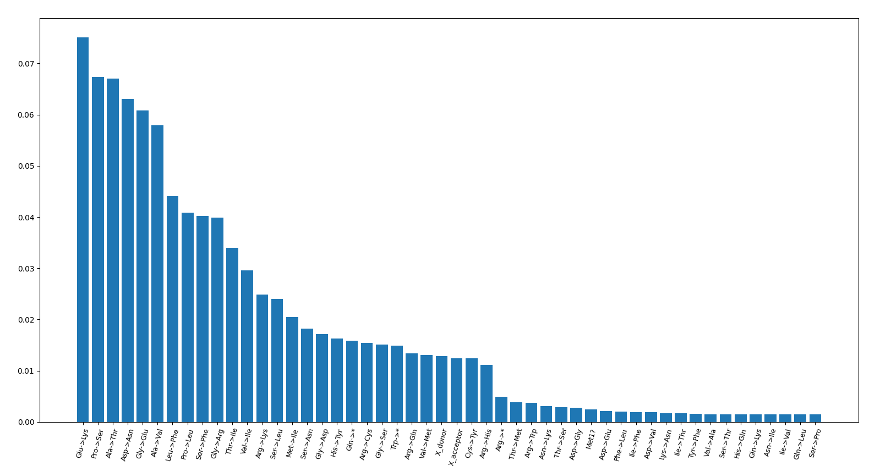
Che-3

Slide 24
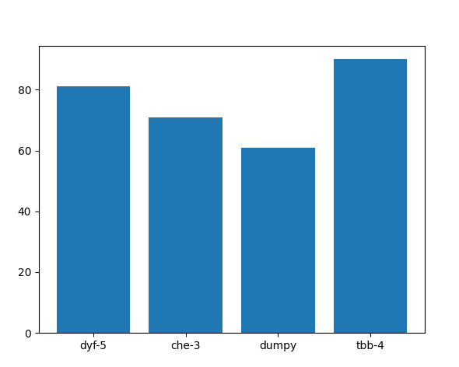
Impact mutation per sample

Slide 25
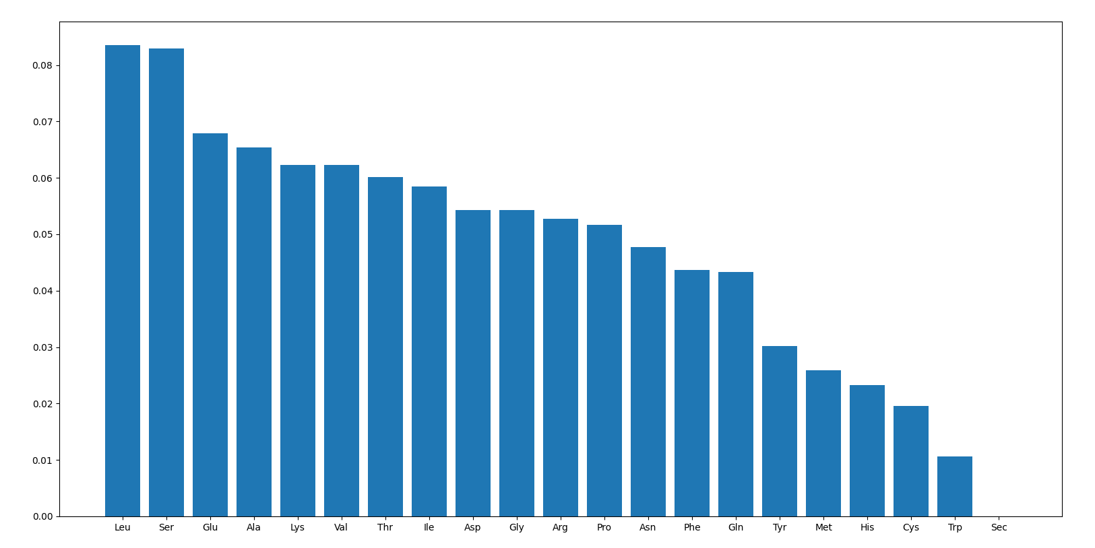
Amino acid frequency

Slide 26
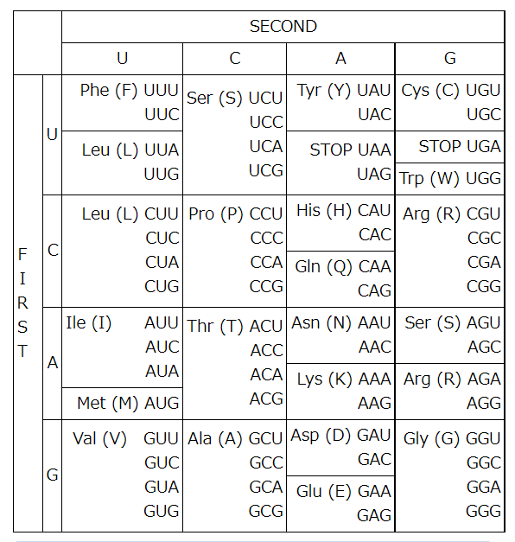
C>U or G>A

Slide 27
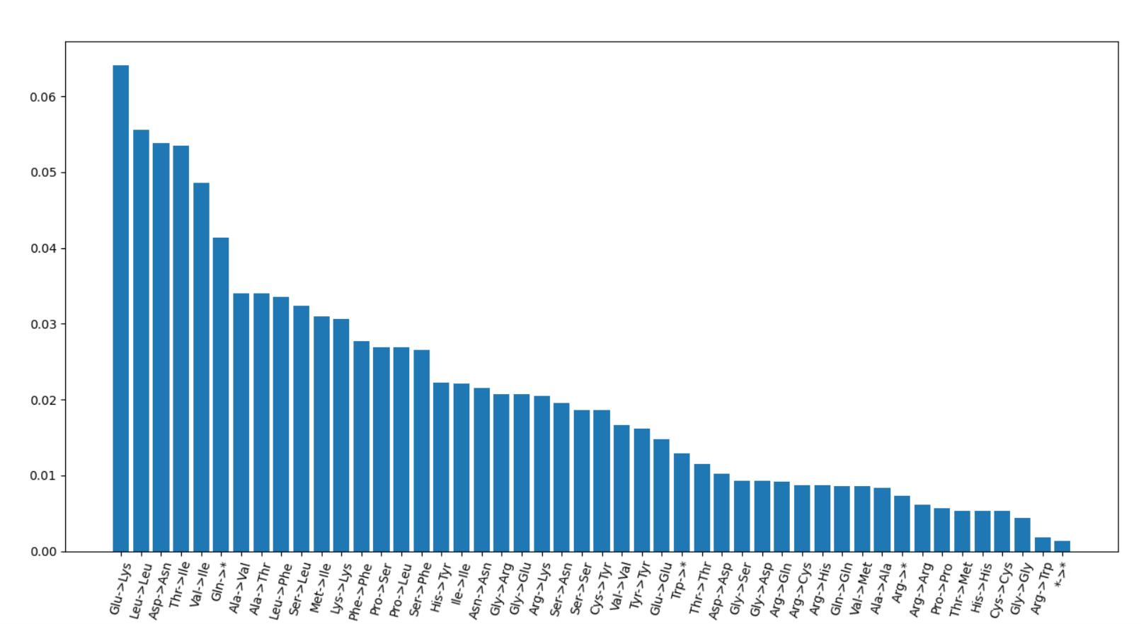
Take codon usage, amino acid count, and EMS-induced codon change into consideration
1
5
6
2
3
4

Slide 28
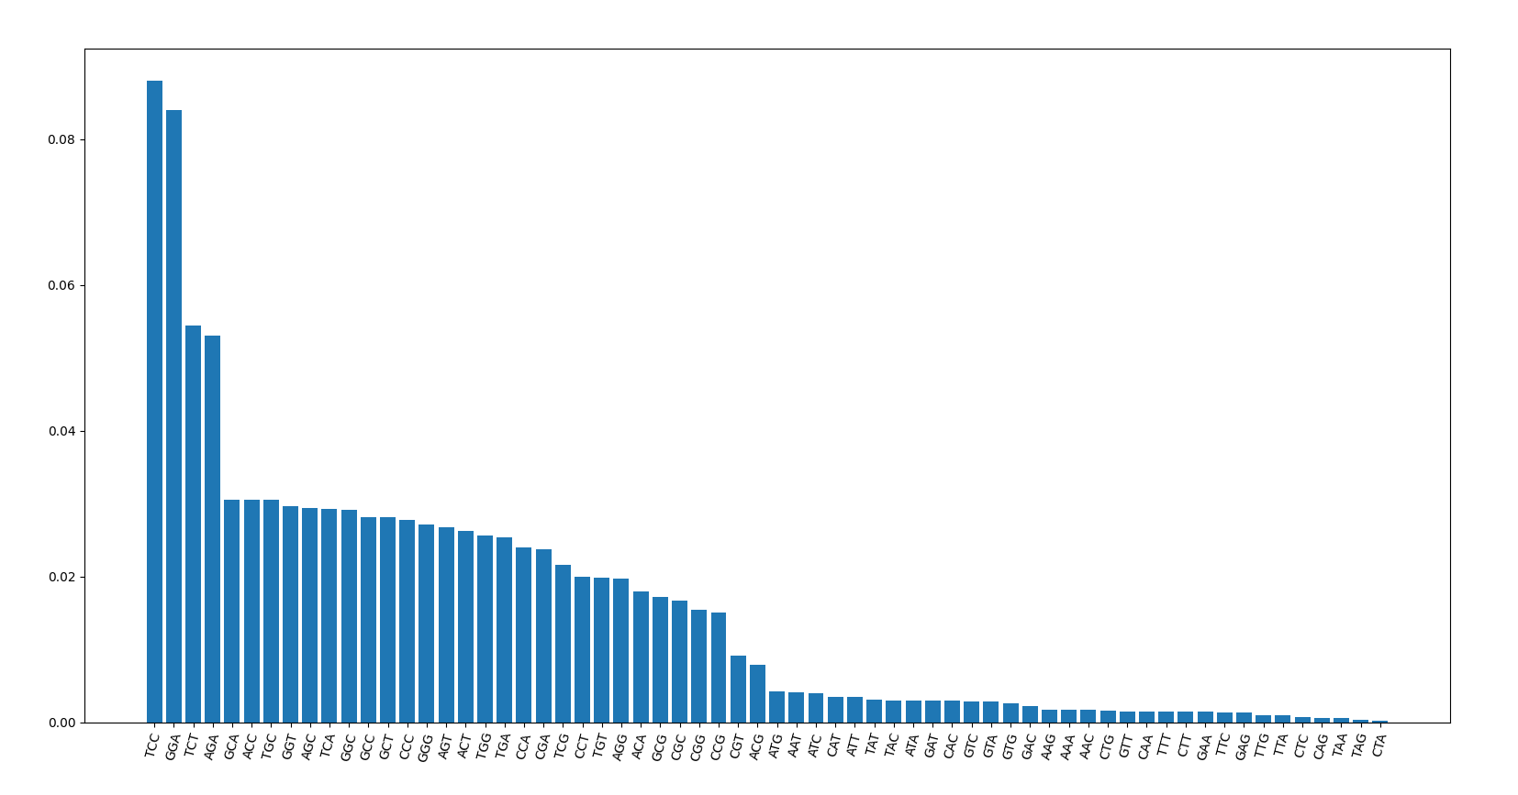
Neighbor base-pairs?
dumpy

Slide 29
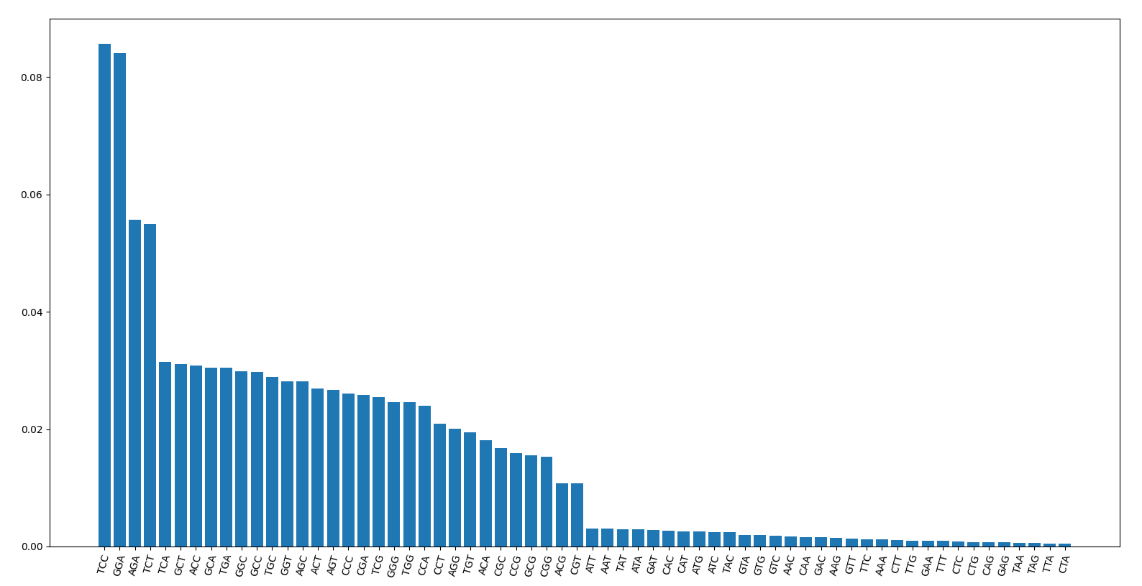
Tbb-4

Slide 30
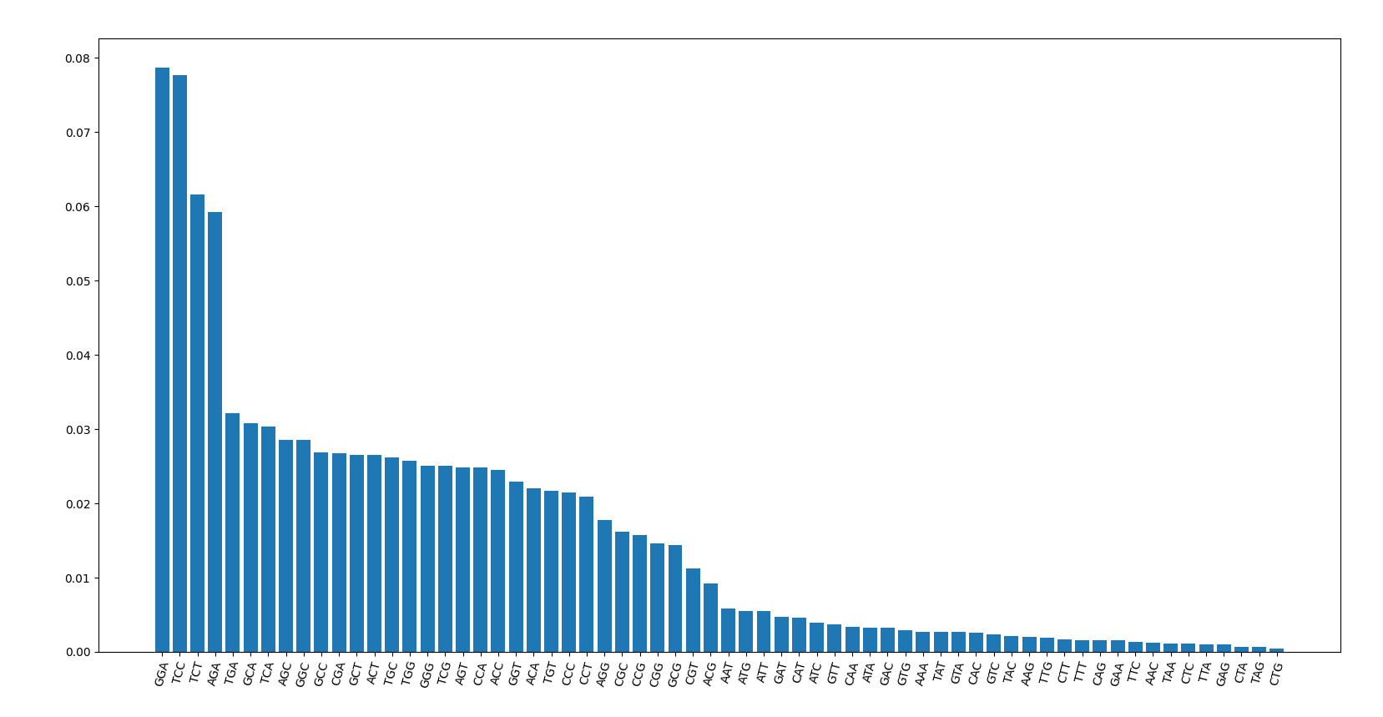
Che-3

Slide 31

Dyf-5

Slide 32
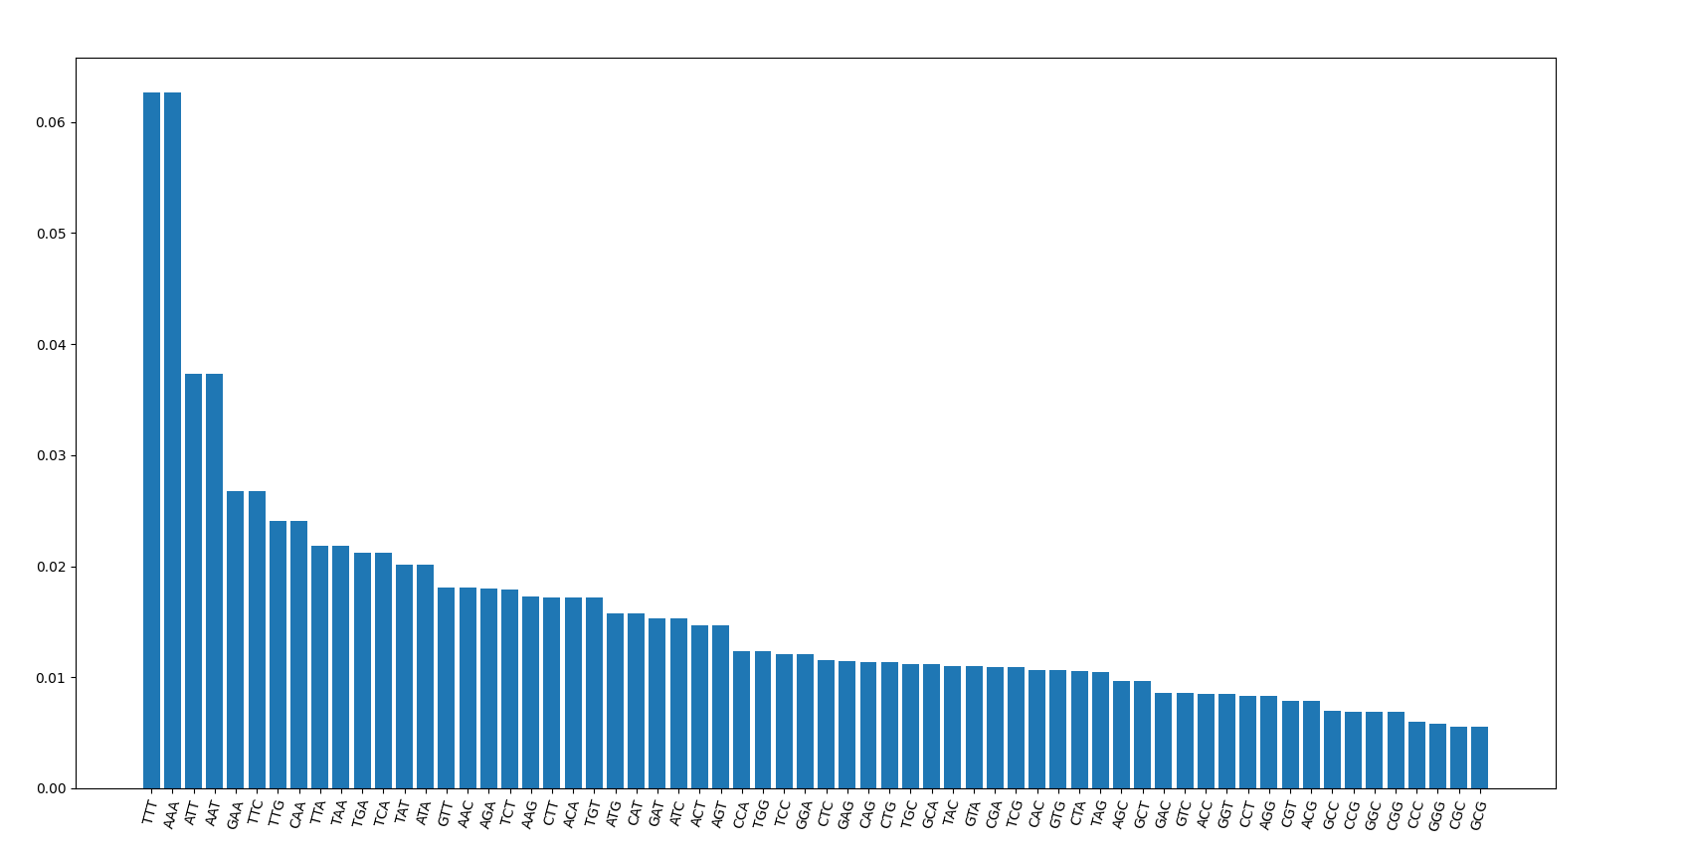
Neighbor combination of C elegans genome
TCT
AGA
TCC
GGA

Slide 33
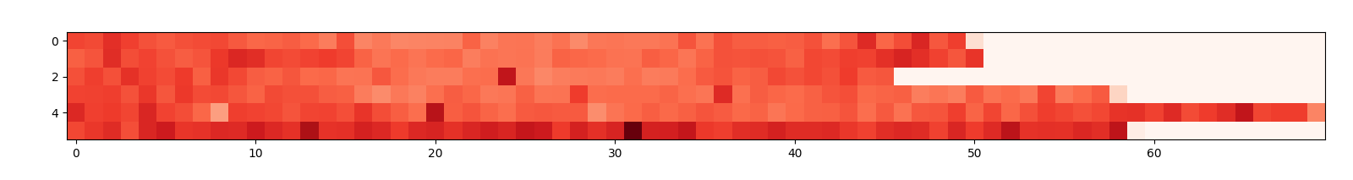
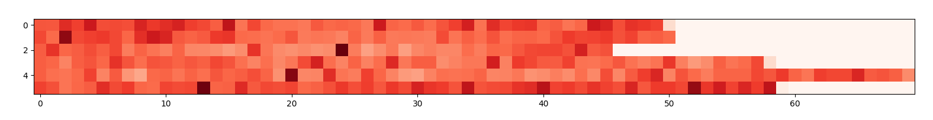
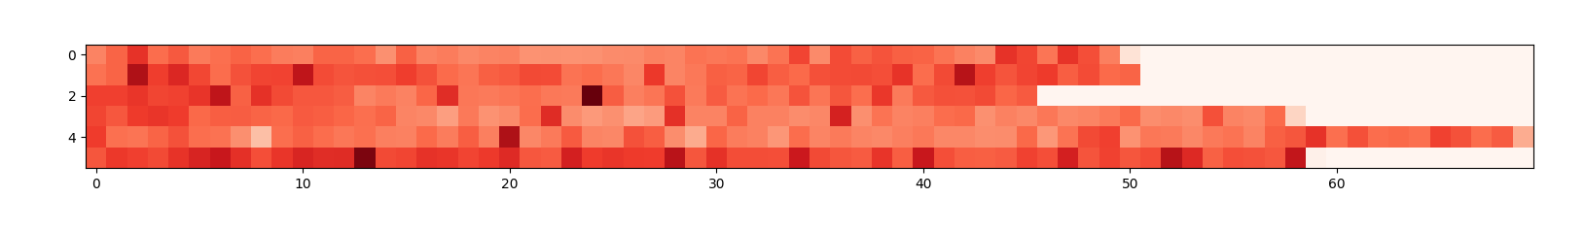
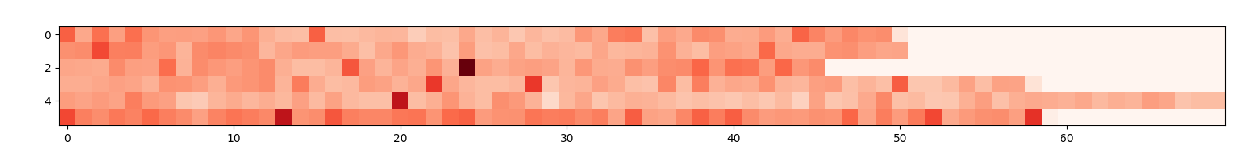
Mutation frequency per 300000 base
tbb-4 (438)
tba-5 (195)
dumpy (256)
unc (120)

Slide 34
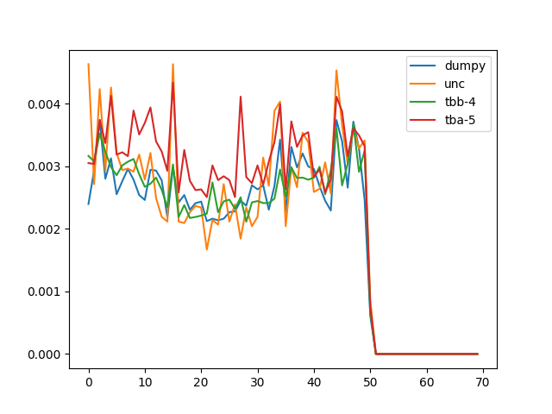
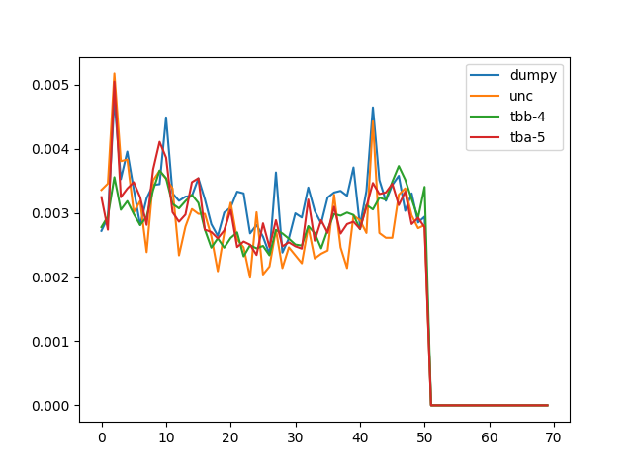
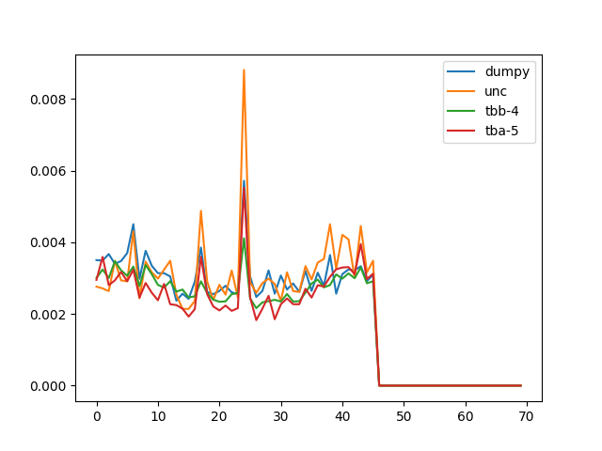
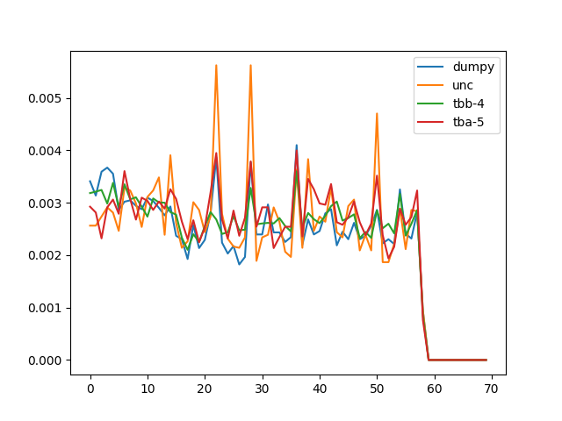
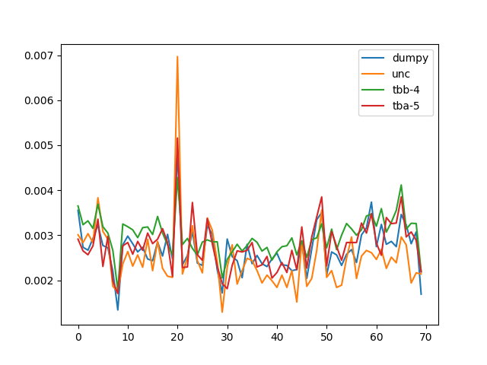
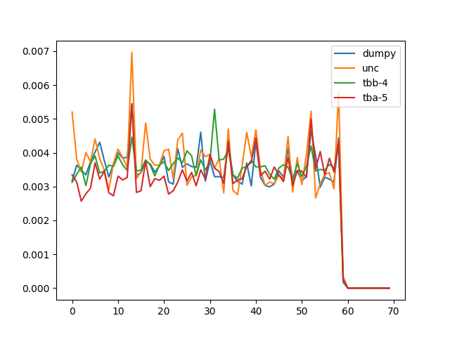
Mutation frequency per 300000 base
I
II
III
IV
V
X

Slide 35
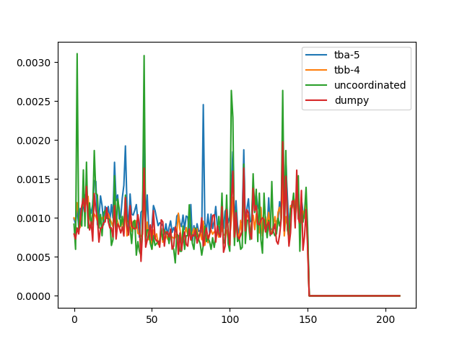
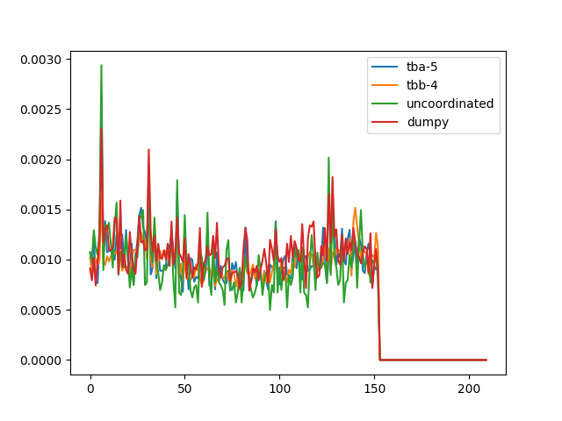
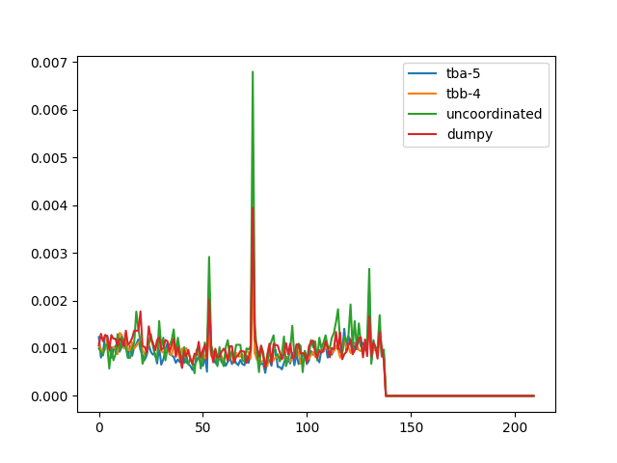
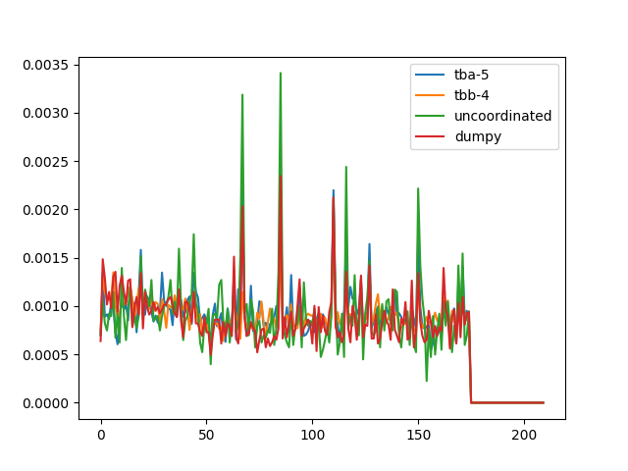
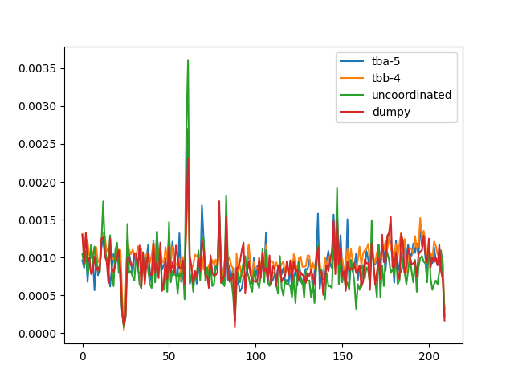
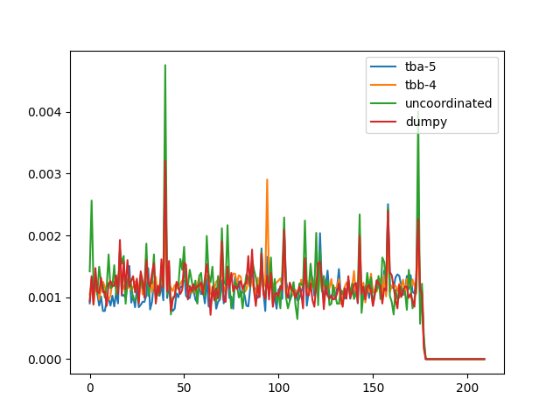
I
II
III
IV
V
X

Slide 36
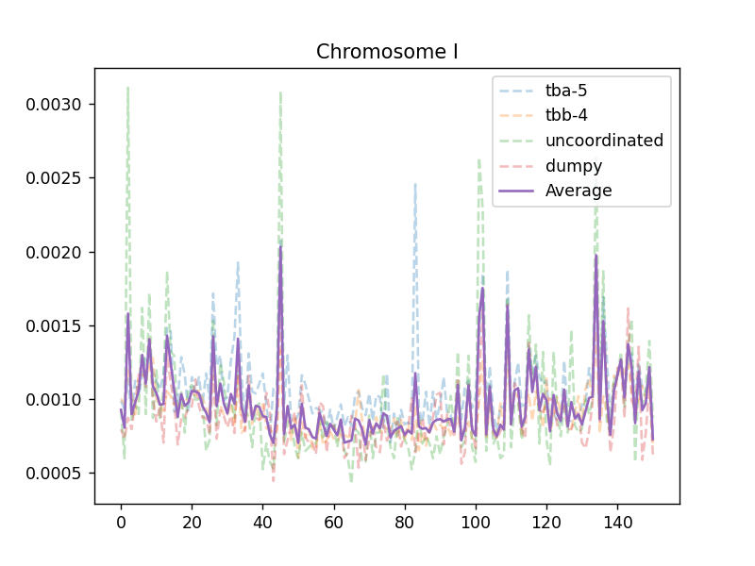
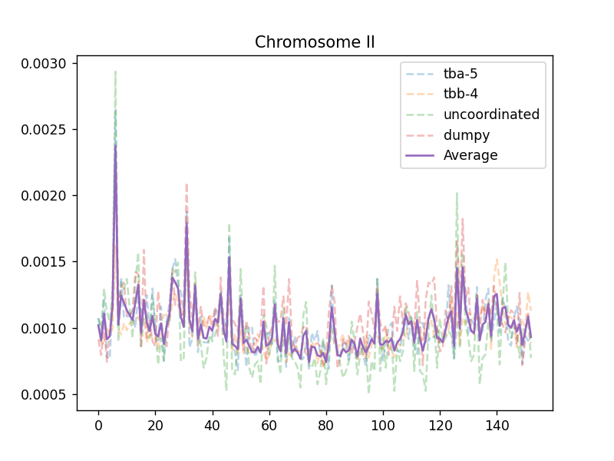
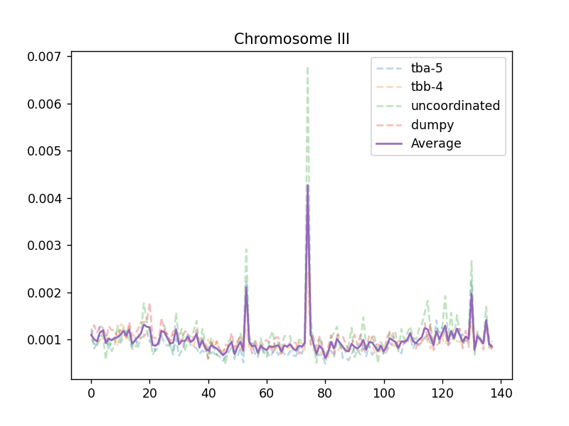
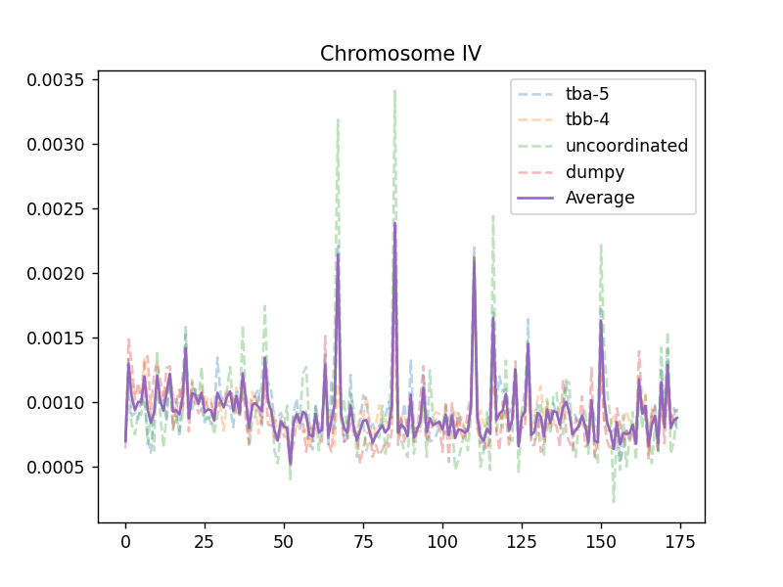
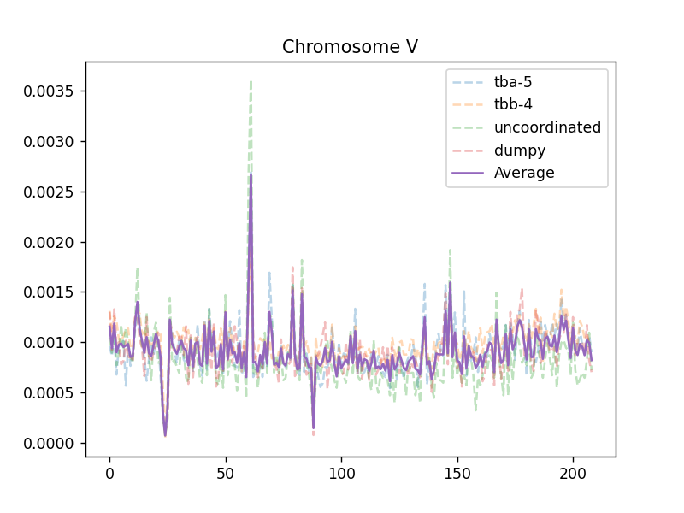
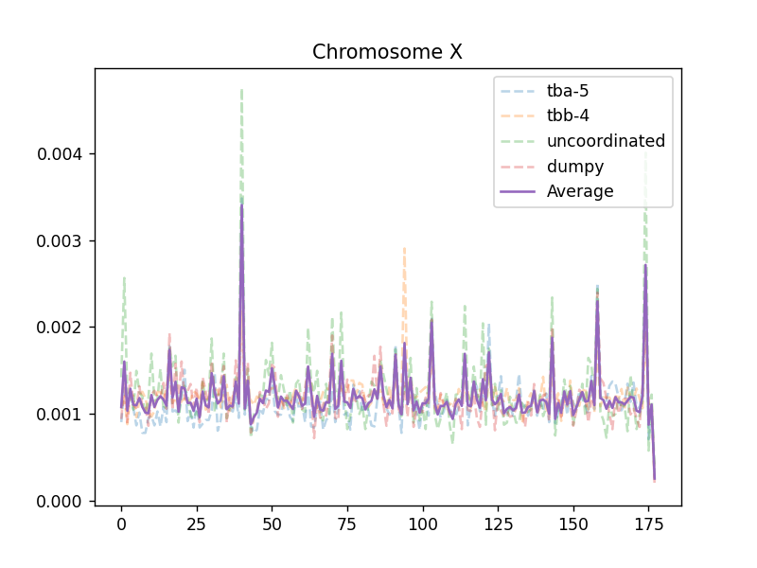

Slide 37
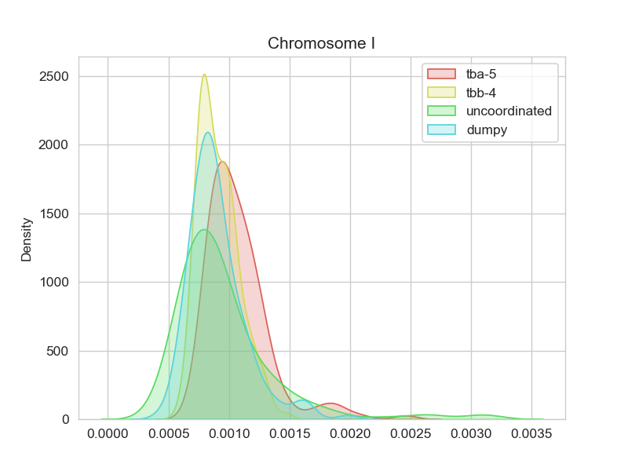






Slide 38


Std.

Slide 39


High frequency outlier
（≥Mean + std）
Low frequency outlier
（≤Mean - std）

Slide 40


High frequency outlier
（≥Mean + 2*std）
Low frequency outlier
（≤Mean - 2*std）

Slide 41

thriple-base in high freq region

Slide 42

thriple-base in low freq region

Slide 43

high-low

Slide 44

High-std

Slide 45

Low-std
Percentage of A-T,G-C

Slide 46




A/T percentage
dumpy
P(MUT)
lg(P(MUT))
A/T percentage
2
P(A/T) – 0.6
(P(A/T) – 0.6)

Slide 47


P=3.150339e-25
Spearman = -0.2286
y = -21.59x-7.587
P(MUT)
lg(P(MUT))
P(A/T) – 0.6
(P(A/T) – 0.6)

Slide 48





dumpy
‘A/T’
Poly A
Poly C
Poly A/C
exon

Slide 49


Spearman = 0.2342
p=0.2941
Spearman = 0.3434
p=1.1249e-56
mut
Poly A
Poly C

Slide 50

Spearman = -0.2155
p=1.614e-22
How to explain the hotspot/cold spot?
exon

Slide 51

Rate = mut(triple)/count(triple)

Slide 52



…ATGCGAATTGCCACT…
Code1
‘ATG’
Code2
‘TGC’
Code3
‘GCG’
Mutation rate:
r$\left[code\right]=\frac{mut\left[code\right](all genome)}{n[code](all genome)}$
$$std=\sqrt{\frac{\sum_{i=1}^{64}{{(n_{i}[code]−p_{i}[code])}^{2}}}{n}}$$
Predicted mutation:
$$p\left[code\right]=r\left[code\right]∗n[code](300,000bp)$$
Tbb-4
std
13.09

Slide 53



dumpy
dumpy
std
Tbb-4
std
tbb-4
dumpy

Slide 54




Only focus on ‘C’ and ‘G’ mutation
dumpy
Tbb-4
12.9
High variation due to genomic repair?
|Dumpy std – tbb-4 std|
G/C only

Slide 55




How many base should I use to evaluate the mutation frequency of the central base?
+ chain: exp:
A:32371810 0.32279
T:32373344 0.32280
C:17782105 0.17731
G:17759142 0.17708
Chi-square test for
each position

Slide 56

0.1769 7.7156 22.8757 28.4276 58.2035 16.9557 5.8219 2.6879
0.9812 0.0522 4.28e-5 2.95e-6 1.42e-12 7.21e-5 0.1206 0.4422
-2/-1/0/1/2 is the best pattern

Slide 57

Why triple codon?
5 –base combination also in a symmetric pattern

Slide 58


Remaining the same in different screening data
OSM-3
tbb-4
dumpy
TTN-1

Slide 59


How accurate can this model predict EMS mutagenesis
TBB-4 data
(Count-predicted)/predicted
accuracy
±0.5：3173/4464 = 71.08%
Gene length
±0.3：1943/4464 = 43.53%

Slide 60


dumpy data
±0.5：726/1147 = 63.30%
±0.3：473/1147 = 41.2%

Slide 61


P-val binorminal distribution padj:BH tbb-4 data
padj
Gene length
<0.05：1183/26239 = 4.51%
<0.01：559/26239 = 2.13%
<0.001：271/26239 = 1.03%

Slide 62


P-val binorminal distribution padj:BH dumpy data
padj
Gene length
<0.05：113/20160 = 0.5%

Slide 63

probability
length

Slide 64



ttn-1

Slide 65



tbb-4

Slide 66



dig-1

Slide 67



Cla-1

Slide 68



tba-5

Slide 69


Silent region
Chrom V:
X10^6
Consist with the TF binding activity

Slide 70


Chrom:X

Slide 71



PolII Early embryo stage
Lin-54 L3 stage
Lin-37 LTemb stage
Dumpy real data

Slide 72


Real data(dumpy)
P[code]
Pol II binding activity
a(experiment)*f(P[code])*f(Chromasome structure)*something else?

Slide 74


Spearman = 0.23
p=1.774e-25
Spearman = 0.23
p=1.774e-25
Really happened
Really happened
Predicted
PolII ChIP-seq

Slide 75

?
Mut freq in intron is lower
Tbb : total mutation snp: 184594
intron variant: 7225
total intron length: 13780055
predict to have 25196.8 mutations
so why?
Chrom I kde plot

Slide 76
Red outliers
1.5 * IQR
0.00306919244550399
blue
0.0004136708362060475
0.00016339201829990605
Middle:7564460, low: 3760398, high: 3747572

Slide 77


Slide 78


Slide 79



5bp C/G only
7bp
7bp C/G only

Slide 80




C
G
A
T

Slide 81


Slide 82

Tbb-data with tbb

Slide 83
Discussion
2022/11/2

Slide 84
EMS screening
Osm-3 p802
G444E
Test cross and Mapping
Whole Genome Sequencing
Phenotype II
dye-filling
Phenotype I
Compare with wildtype
And Mapping samples
~300 Single nucleotide variation due to EMS
Can focus on about ¼ length of a Chromosome

Slide 85
SNP pool of
osm-3(sa125) suppressors
Unc-89
Nekl-4
ttn-1
Gene x

Slide 86
Mutation frequency per 300000 base
tbb-4 (438)
tba-5 (195)
dumpy (256)
unc (120)

Slide 87

EMS mutagenesis

Slide 88
How many base should I use to evaluate the mutation frequency of the central base?
+ chain: exp:
A:32371810 0.32279
T:32373344 0.32280
C:17782105 0.17731
G:17759142 0.17708
Chi-square test for
each position

Slide 89
0.1769 7.7156 22.8757 28.4276 58.2035 16.9557 5.8219 2.6879
0.9812 0.0522 4.28e-5 2.95e-6 1.42e-12 7.21e-5 0.1206 0.4422
-2/-1/0/1/2 is the best pattern

Slide 90
Why triple codon?
5 –base combination also in a symmetric pattern

Slide 91
ttn-1
184594:18 per 10kb

Slide 92
tbb-4

Slide 93
dig-1

Slide 94
Cla-1

Slide 95
tba-5

Slide 96
Silent region
Chrom V:
X10^6
Consist with the TF binding activity

Slide 97
Chrom:X

Slide 98


Slide 99


Slide 100
PolII Early embryo stage
Lin-54 L3 stage
Lin-37 LTemb stage
Dumpy real data

Slide 101
Real data(dumpy)
P[code]
Pol II binding activity
a(experiment)*f(P[code])*f(Chromasome structure)*something else?

Slide 102





